Slide 1
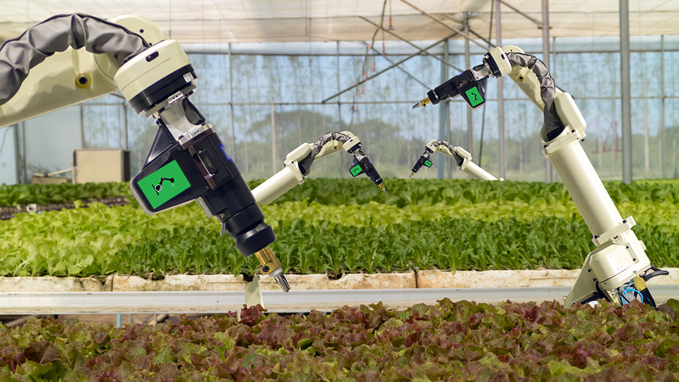

AI IN AGRICULTURE
AI in Agriculture
Submitted By:
(S.No. 57 – Mayank Choudhary)
(Enrolment Number - 35515002818)

Slide 2
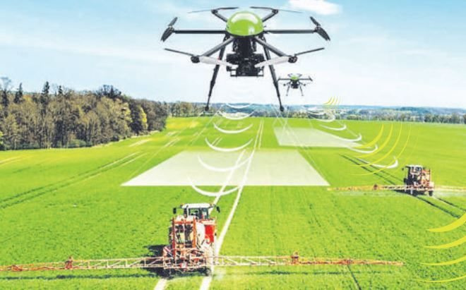
AI is making a huge impact in all domains of the industry. Every industry looking to automate certain jobs through the use of intelligent machinery. And a good Artificial Intelligence Course Online is all you need to break into any industry. Even Agriculture!
Agriculture and farming are one of the oldest and most important professions in the world. It plays an important role in the economic sector. Worldwide, agriculture is a $5 trillion industry.
The global population is expected to reach more than nine billion by 2050 which will require an increase in agricultural production by 70% to fulfill the demand. As the world population is increasing due to which land water and resources becoming insufficient to continue the demand-supply chain. So, we need a smarter approach and become more efficient about how we farm and can be most productive
In this article, I will cover are challenges faced by farmers by using traditional methods of farming and how Artificial Intelligence is making a revolution in agriculture by replacing traditional methods by using more efficient methods and helping the world to become a better place.

Slide 3
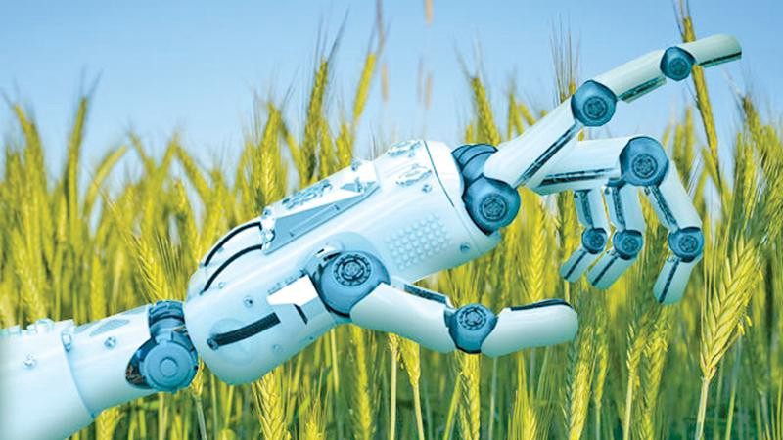
Scope of technology
Artificial intelligence is based on the principle that human intelligence can be defined in a way that a machine can easily mimic it and execute tasks, from the simplest to those that are even more complex. The goals of artificial intelligence include learning, reasoning, and perception.
The technologies which are AI-based help to improve efficiency in all the fields and also manage the challenges faced by various industries including the various fields in the agricultural sector like the crop yield, irrigation, soil content sensing, crop- monitoring, weeding, crop establishment. Agricultural robots are built in order to deliver high valued application of AI in the mentioned sector. With the global population soaring, the agricultural sector is facing a crisis, but AI has the potential to deliver much-needed solution. AI- based technological solutions has enabled the farmers to produce more output with less input and even improved the quality of output, also ensuring faster go-to- market for the yielded crops. By 2020, farmers will be using 75 million connected devices. By 2050, the average farm is expected to generate an average of 4.1 million data pointsevery day.

Slide 4
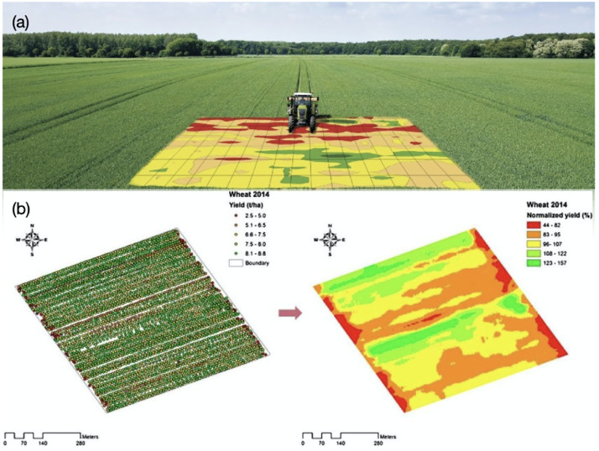
Applications of Artificial Intelligence in Agriculture
The industry is turning to Artificial Intelligence technologies to help yield healthier crops, control pests, monitor soil, and growing conditions, organize data for farmers, help with the workload, and improve a wide range of agriculture-related tasks in the entire food supply chain.
Use of weather forecasting: With the change in climatic condition and increasing pollution it’s difficult for farmers to determine the right time for sowing seed, with help of Artificial Intelligence farmers can analyze weather conditions by using weather forecasting which helps they plan the type of crop can be grown and when should seeds be sown.

Slide 5
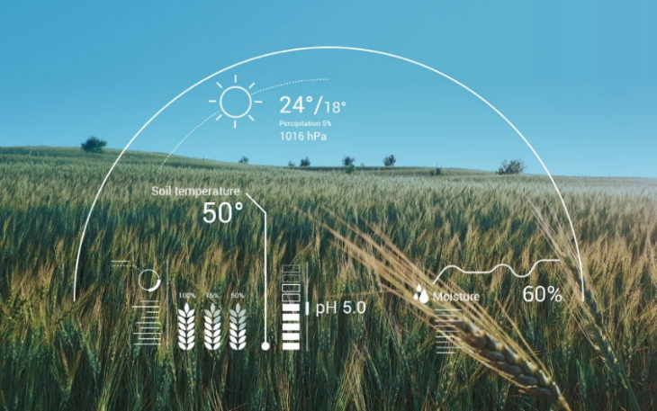
Soil and crop health monitoring system: The type of soil and nutrition of soil plays an important factor in the type of crop is grown and the quality of the crop. Due to increasing, deforestation soil quality is degrading and it’s hard to determine the quality of the soil.
AI-based application can identify the nutrient deficiencies in soil including plant pests and diseases by which farmers can also get an idea to use fertilizer which helps to improve harvest quality. This app uses image recognition-based technology.

Slide 6
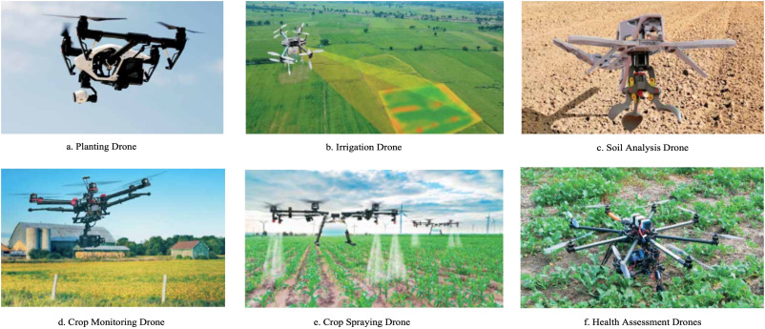
Analyzing crop health by drones: SkySqurrel Technologies has brought drone-based Ariel imaging solutions for monitoring crop health. In this technique, the drone captures data from fields and then data is transferred via a USB drive from the drone to a computer and analyzed by experts.
This company uses algorithms to analyze the captured images and provide a detailed report containing the current health of the farm. It helps the farmer to identify pests and bacteria helping farmers to timely use of pest control and other methods to take required action

Slide 7
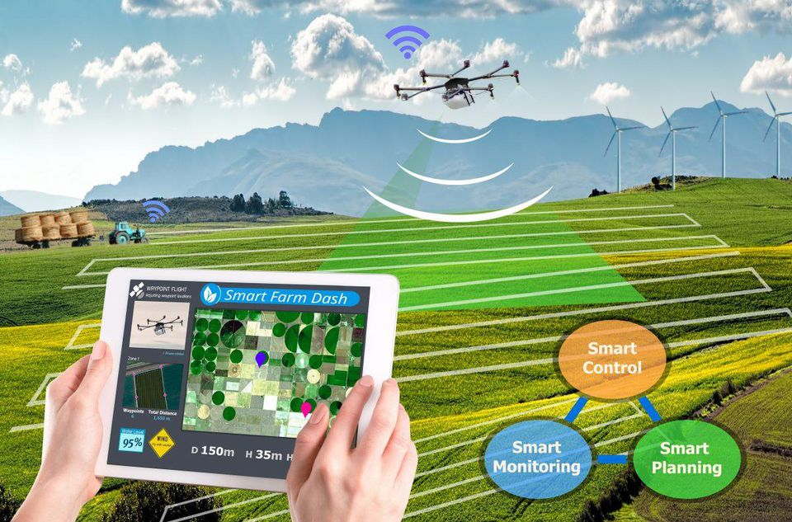
Challenges
Agriculture has been tackling significant difficulties like absence of irrigation system, change in temperature, density of groundwater, food scarcity and wastage and substantially more. The fate of cultivating depends to a great extent on reception of various cognitive solutions. While large scale research is still in progress and some applications are already available in the market, the industry is still highly underserved.
When it comes to handling realistic challenges faced by farmers and using autonomous decision making and predictive solutions to solve them, farming is still at a nascent stage. In order to explore the enormous scope of AI in agriculture, applications need to be more robust.

Slide 8
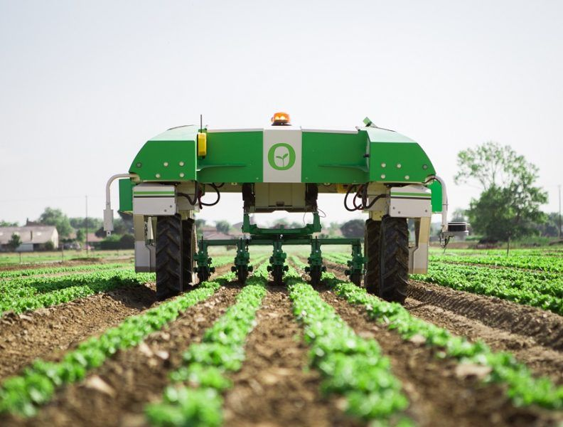
Future Scope
Artificial Intelligence in agriculture not only helping farmers to automate their farming but also shifts to precise cultivation for higher crop yield and better quality while using fewer resources.
Companies involved in improving machine learning or Artificial Intelligence-based products or services like training data for agriculture, drone, and automated machine making will get technological advancement in the future will provide more useful applications to this sector helping the world deal with food production issues for the growing population.

